Slide 1

Winter Flying Safety
October 1, 2024

Slide 2
Winter Flying: Phases of Flight
Preflight (including Wx briefing)
Taxi & Takeoff
Enroute
Initial Descent
Approach & Landing
Post-Flight
Night Currency
  Due to shorter days, many flights may be completed at night
  Are you Night Current?

Slide 3

Preflight Briefing / Planning
Briefing should include the following:
  Forecast freezing levels along your route of flight
  AIRMETs for icing conditions (AIRMET Zulu)
  Cloud bases along your route of flight
  Wx at destination airport including runway conditions
  These are in addition to “normal” preflight items
    PIREPs, TFRs, NOTAMS, significant weather, etc.
  VFR flights should be planned clear of clouds
  IFR flights should plan to avoid IMC when enroute altitude is at or below freezing
  The MEA may make this impossible during winter months
  ForeFlight users should take advantage of available
  flight-planning and briefing tools.

Slide 4
Preflight Operations (Snow Removal on the Apron)
The Airport Authority plows Taxi Lanes to within (5) feet of the hangars
The (5) feet closest to the hangar, as well as the sidewalks, are the Tenant’s responsibility (That’s Condor!)
If you have the first flight following a snowfall, please clear snow from the first (5) feet from the hangar, as well as paths for the aircraft tires
  You may shovel snow into a Taxi Lane before it is cleared
  Please do NOT shovel snow into a previously-cleaned Taxi Lane
  Hangar items to assist in snow removal: Snow Shovel, Bucket of Sand

Slide 5
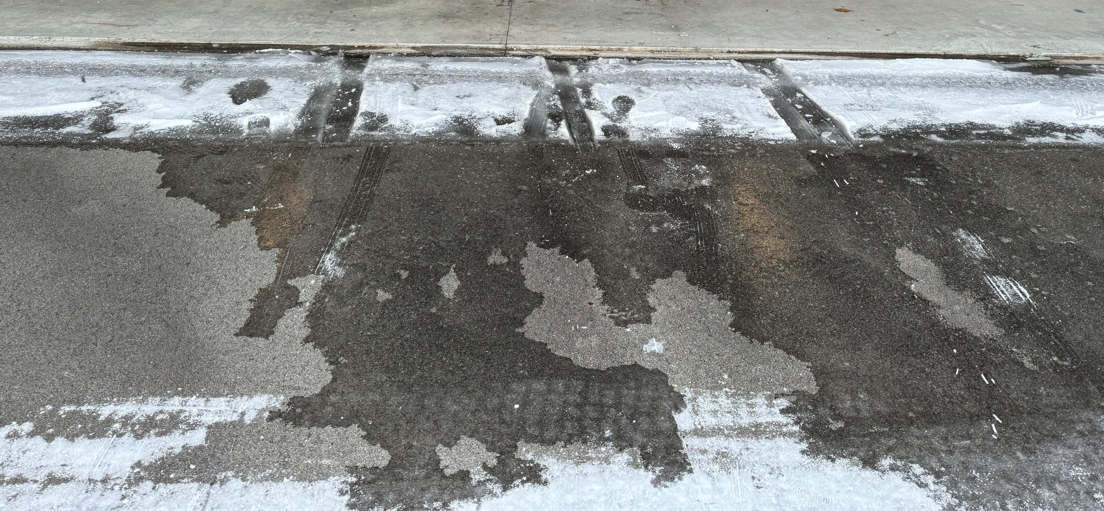
Preflight Operations (Snow Removal on the Apron)
Refrain from driving and/or walking on fresh snow as it gets compacted, which forms ice
Hangar items to aid in snow removal: Snow Shovel, Bucket of Sand

Slide 6
Preflight Operations (Walk-Around)
Cold weather pre-flights tend to be abbreviated (hurried) due to cold weather.
Unplug Engine Heater
(Heaters should be plugged in between Nov. 1st – Mar. 31st)
  Electric oil pan heaters work well to ~ 20°F
  Install cowl plugs (if available)
  If the previous member forgot to plug in the Engine Heater, expect starting difficulty
Remove Cowl Plugs
Removal of snow, ice, and frost
  Airfoil & control surfaces
    A thin layer of frost (1-2 mm) can reduce lift by up to 33%
  Air intakes, fuel vents, pitot tube & static ports

Slide 7
Preflight Operations
(Walk-Around)
Gently rock wings before sumping fuel.
  Cold weather aggravates condensation of moisture in fuel tanks
Inspect Oil Breather for blockage due to frozen moisture.
  A clogged Oil Breather causes the crankcase to pressurize, potentially causing
  engine failure.
  Look for the “whistle slot” in the Breather pipe.
Give the Exhaust Manifold a “good tug” to be sure it is secure.
(Caution: it could be hot!)
NOTE: Contrary to popular practice, the Exhaust Manifold is NOT the best place to attach the ground cable when fueling, as it is poorly bonded to the airframe ground (the fuel-filler necks).
A tie-down ring is a much better choice.
“Grounding While Fueling” Video (YouTube)

Slide 8
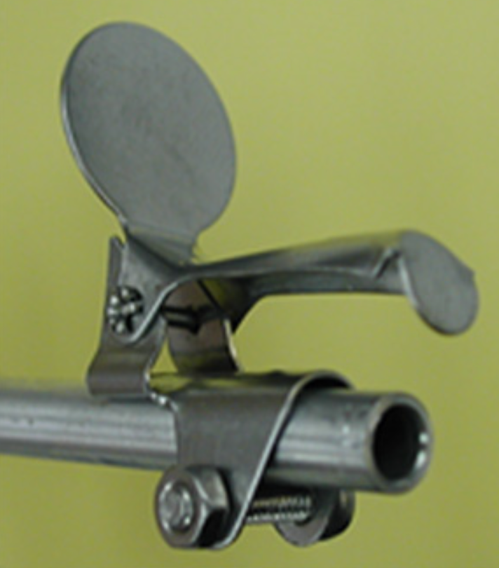
Preflight Operations (Walk-Around)
Inspect Pitot/Static system & Pitot Heat
  Pitot Tube & Static Vents should be clear and unobstructed
  Check Pitot Heat for proper operation
  (Careful: Will get HOT !!)
  On Cessnas, check that the Pitot Cover moves freely
When back in the airplane, check the Fuel Selector Valve for freedom of movement
  It may be frozen in place

Slide 9
Engine Start
(Lycoming Recommendations)
Use of Primer:
  60° F Range: (1) stroke of Primer
  50° F Range: (2) strokes of Primer
  40° F Range: (3) strokes of Primer
Starting Engine
  Engage Starter for short periods (10 second), and then allow to cool.
  If engine has not started after (3) such periods, a (5) minute cooling-off period is required to avoid overheating and/or damaging the Starter.
Check Oil Pressure
  After the engine has started, check for Oil Pressure.
  If no oil pressure is indicated, immediately shut down to avoid damage to the engine.

Slide 10
Engine Start
(Lycoming Recommendations)
Use of Primer vs. Pumping the Throttle
  The Primer injects fuel into the cylinder(s).
  Pumping the Throttle uses the carburetor’s Accelerator Pump to inject fuel into the carburetor (for acceleration).
    Fuel injected into the carburetor without the engine cranking will “dribble down” the carburetor, and onto the air intake, lower cowling, and possibly, the ground.
    This causes a risk of fire.
  See video on next slide
  Secondary video here: Accelerator Pump Video (YouTube)

Slide 11
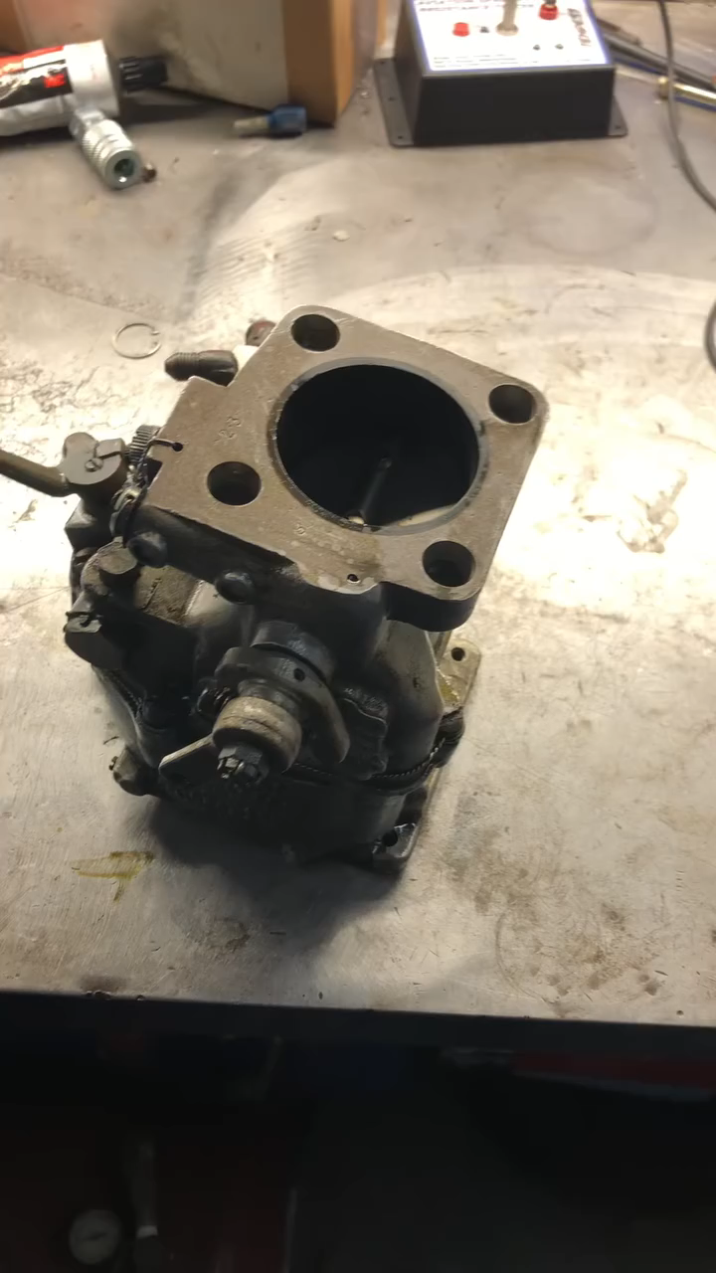

Slide 12
Engine Start
(Condor-Recommended Cold-Weather Starting Procedures)
Refer to:
  “Amplified Procedures” in aircraft’s POH
  “Cold-Weather Starting Cheat Sheet” on the Condor website
Avoid high-RPM start (shoot for 1000 RPM)
Caution: STOP CRANKING if:
  The engine doesn’t start after (4) attempts
    Let the engine “sit” for (10) minutes before re-attempting starting
    Continuous cranking is very hard on the engine and starter, and will eventually
    run-down the battery requiring a jump start.
    (If a battery is dead, please follow maintenance reporting procedures)
  If you smell fuel, or notice a blue puddle (Avgas) under the engine:
    You have likely flooded the engine, and there is a risk of fire.
    This is an good time to know where to find a fire extinguisher
    (either in the aircraft or in the hangar)

Slide 13
Engine Start
(Condor-Recommended Cold-Weather Starting Procedures)
Condor Aircraft with Lycoming Carbureted Engines
(N89549, N96573, N62104, N98887, N2806M, N4335M)
  Prime the engine using the Primer, no more than (2) times
  (When pulling the primer knob out, listen for the primer filling with fuel
  before pushing it back in)
  Advance the throttle to full-open and back to the closed position (2) times
  (This uses the carburetor’s Accelerator Pump)
  Leave the Throttle fulled-closed (idle)
  Engage the Starter. If the engine fires, but does not continue to run, pump the throttle a couple times while cranking the engine – but only small pumps
NOTE: Excessive pumping of the Throttle could lead to an engine fire.

Slide 14
Taxiing
Taxi slower than normal & avoid hard braking
Avoid taxiing thru areas of snow & slush
  Snow & slush can be thrown into wheel wells (or pants) which could
  freeze & lock wheels or brakes
Attempt to keep the nose wheel on centerline to avoid wingtips striking snow drifts, plowed snow, or other objects
  Beware of KPJC taxiway centerlines at the north and sound ends of the runway.
  They are not centered.
Strong winds can cause weathervaning

Slide 15
Run-up & Takeoff
Run-Up
  Select a dry area (if possible)
    Plane will slide on snow/ice when run-up power applied
  Keep tach below 1000 RPM until oil temp is in green
Takeoff from snow-covered runway
  Consider soft-field takeoff
  Avoid braking – use rudder for steering
  Exercise caution when turning onto runway
On takeoff roll, note & call-out “Airspeed Alive” to ensure that Pitot Tube Cover is not stuck or
frozen in place

Slide 16
Effect of Slush/Snow on Runway
Slush Depth
½ Inch
1 Inch
1- ¼ Inch
2 Inches
Takeoff Distance Increase
15 percent
50 percent
100 percent
Takeoff not possible
Rule of Thumb: If you can’t walk without falling, don’t take off

Slide 17
Enroute
Cabin Heat & Defroster
  Be aware of the effects of Carbon Monoxide poisoning
    Headache, increased respiration, drowsiness, blurred vision
  If symptoms appear, discontinue use, open fresh air vents, and land as soon as possible

Slide 18
Enroute
Pitot Heat
  Use when in IMC or when flying in precipitation
  Be aware of effects of iced up pitot tube or static ports
Monitor Enroute & Destination Weather
  Check ATIS/AWOS, HIWAS, etc. along route of flight
  Utilize ADS-B METARS via aircraft GPS and/or Foreflight, etc.
Monitor outside air temperature
Monitor leading edges, OAT probe, etc. for ice accumulation
Instrument | Static Blockage | Pitot Blockage
Altimeter | "Freezes" at constant value | n/a
Vertical Speed Indicator | "Freezes" at zero | n/a
Airspeed Indicator | Under-reads in climb and over-reads in descent | Over-reads in climb and under-reads in descent

Slide 19
Enroute
Monitor enroute airspeed
  A loss of airspeed is an indication of airframe icing
Monitor engine power settings
  A loss of RPM (fixed pitch prop) or manifold pressure (constant speed prop) is an indication of carburetor ice
  Apply carb heat & leave on for 10-15 seconds or until engine roughness has ceased
    Remember, the engine will run rougher before it gets better! This usually means additional power loss… leave the carb heat on until the roughness smooths out!
Exercise Constant Speed Props every (30) minutes to help prevent oil congealing in the propeller hub.

Slide 20
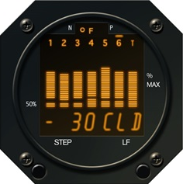
Initial Descent
Prior to power reduction, check Carb Heat
  If not checked, and Carburetor Ice is present, extreme engine roughness may occur
  once power is reduced
Avoid power-off letdowns
  This is especially applicable to cold-weather operations when shock-cooling of the engine is likely (may result in cracked cylinder heads, warped exhaust valves, and bent pushrods)
  Lycoming recommends:
    Letdown speed should not exceed high-cruise speed or 1,000 fpm
    CHTs (Cylinder Head Temperatures) change limited to 50° F per minute
  If aircraft is equipped with an Engine Analyzer, it will display the
  fastest cooling cylinder, and will display a “Shock Cooling” alarm
  if > 60° F per minute (default)
  (This picture shows Cylinder #6 cooling at 30° F per minute)

Slide 21
Approach & Landing
If airframe ice is suspected, do not extend flaps, and use higher than normal approach speeds
Listen to ATIS/AWOS (or unicom) for runway information
  If not available, visually examine runway while in traffic pattern – check for snow drifts, vehicles, etc.
  Be familiar with runway condition reports (5/5/5)
Plan for a soft/short-field landing
Maintain directional control on snow covered runway
  Avoid hard braking – use rudder for steering
  Exercise caution when turning off runway or taxiways

Slide 22
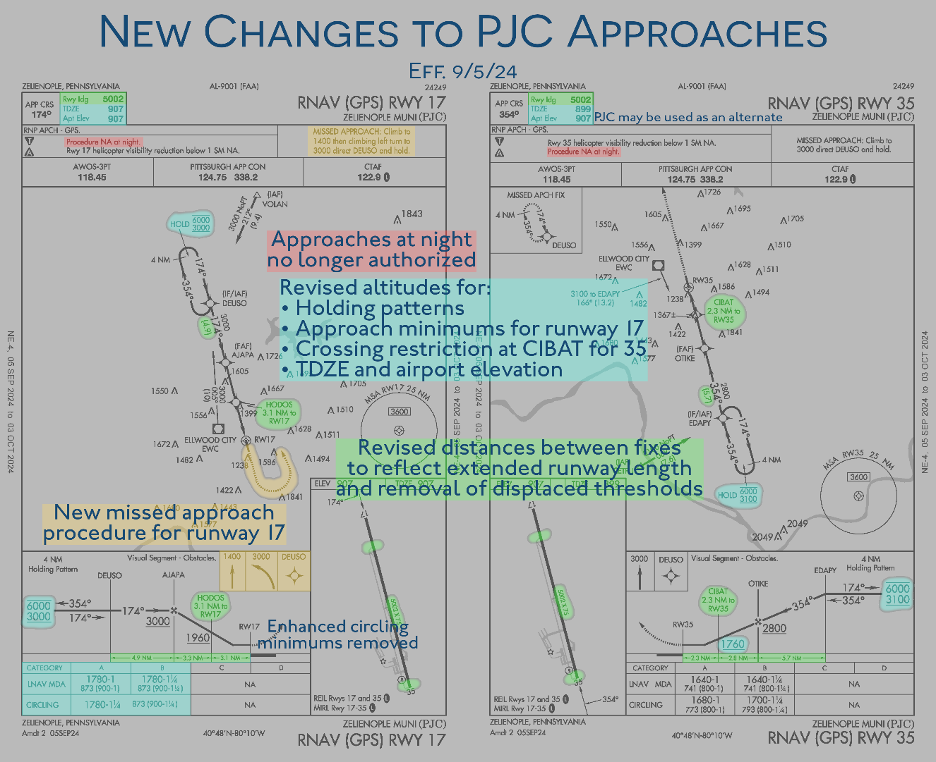
Approach & Landing
Be familiar with the approach!
  PJC approaches have been
  updated as of 9/5/24

Slide 23
Miscellaneous Items
Engine heaters
  Engine heater plugs are accessed thru the engine cowling oil door
  Heaters should be plugged in after each flight (November 1st to March 31st)
  If parking off-field, take an orange extension cord with you, located in the
  Pilot’s Lounge and/or the hangar.
Fire Extinguishers are hanging on the wall in each hangar behind the aircraft’s right wing
RNAV (GPS) RWY 35 and RNAV (GPS) RWY 17 approaches are temporarily NOT APPROVED at night.
Runway 17 operations are now approved between sunset and sunrise (previous NOTAM has been lifted)

Slide 24
Summary
Winter provides spectacular scenery and great aircraft performance
With attention to the elements, winter flying can be both safe & enjoyable
Questions?

